Slide 1




Nutrigenomics
NEW ZEALAND
Nutrigenomics
- A source of new statistical challenges
Chris Triggs, Lynn Ferguson,
The University of Auckland,
Auckland, New Zealand

Slide 2

Nutrigenomics:
how nutrients affect genes
i.e. diet/gene interactions

Slide 3
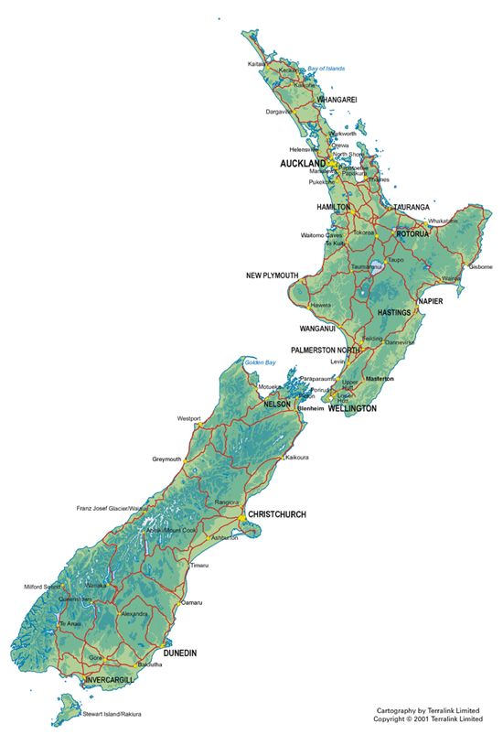



What is Nutrigenomics New Zealand?
• Nutrigenomics New Zealand is a national, collaborative research program between three major research organisations:
• It began in June 2004 and has multi- regional ethics approval
• It has approximately 60 members, mainly scientists
• It is funded by the New Zealand government through the Foundation for Research, Science and Technology

Slide 4

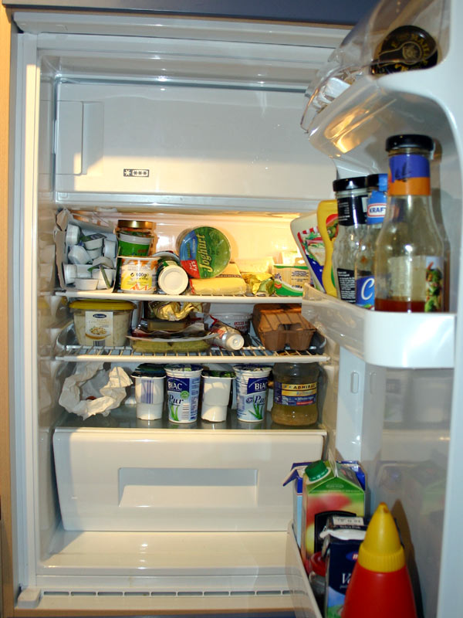
The goals
● Tailored diets to match peoples genes
● Customised foods to optimise health
and minimise disease risks
● Dietary advice for ethnic subgroubs
● Dietary advice for medical conditions

Slide 5

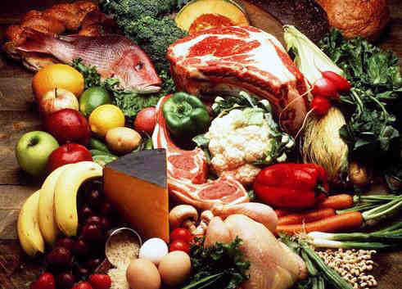
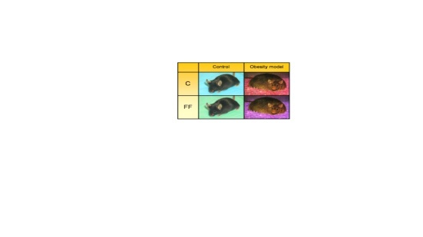

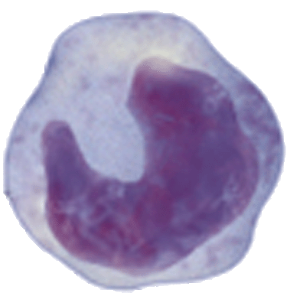
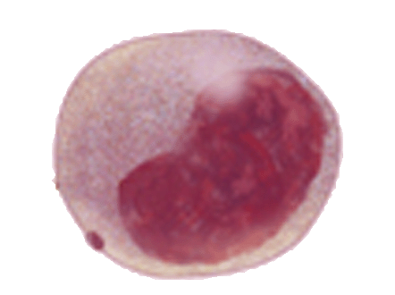
Human
in vivo
Led by The University of Auckland
Food
Agresearch
Animal
in vivo
Human
in vitro
University of Auckland
Plant & Food Research

Slide 6
Inflammatory bowel disease
Proof of principle

Slide 7
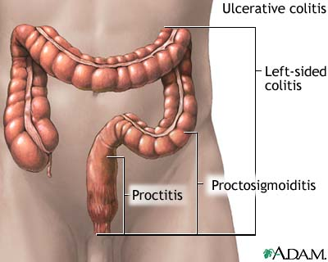
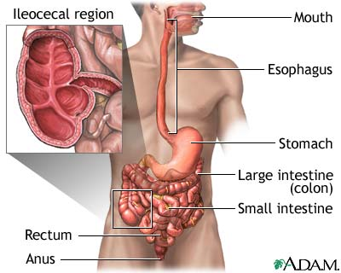
Inflammatory bowel disease (IBD)
Ulcerative colitis: Incidence: 20/100.000
Crohn’s disease: Incidence: 6/100.000
limited to the colon
affects any part of the GI tract
Notes:
2 subphenotypes of IBD

Slide 8
Inflammatory bowel disease in New Zealand children—a growing problem Richard B Gearry, Andrew S Day The inflammatory bowel diseases (IBD), Crohn’s disease and ulcerative colitis, are no longer rare medical conditions seen only by hospital specialists.
NZMJ 3 October 2008, Vol 121 No 1283; Page 5
IBD epidemiology—what’s happening in New Zealand? Over the past 50 years there has been a dramatic rise in the incidence of IBD in New Zealand.
A particularly striking increase in the incidence of CD has been seen in Canterbury…..

Slide 9
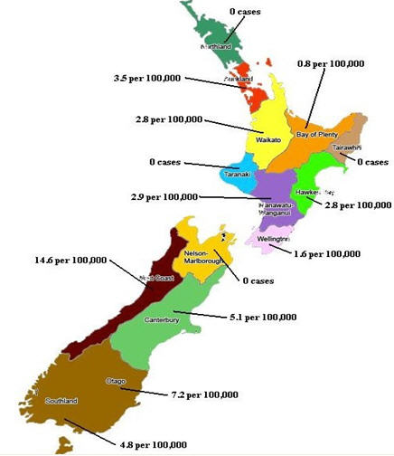
Paediatric inflammatory bowel disease in New Zealand Jason Yap, Alison Wesley, Stephen Mouat, Simon Chin, 2008
Notes:
Can develop at any age, typically 9 – 15
Presenting symptoms; abdominal pain, bleeding, diarrhoea, weight loss
Not observed among Maori – ethnic differentiation observed else where in the world

Slide 10
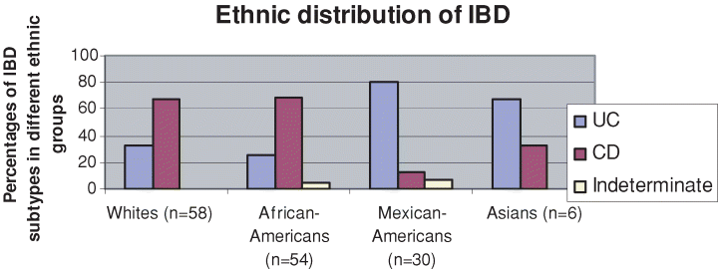
Impact of Race and Ethnicity
Whites had stronger family history of IBD and colorectal cancer.
African Americans with CD had higher incidence of arthritis.
Basu, D; Am J Gastroenterology 100:2254-2261, 2005
Notes:
African American and Caucasiand primaliy had CD while Mexican americans had UC.. P-anca predicotr of pouchitis immune response variations across ethnic groups.

Slide 11
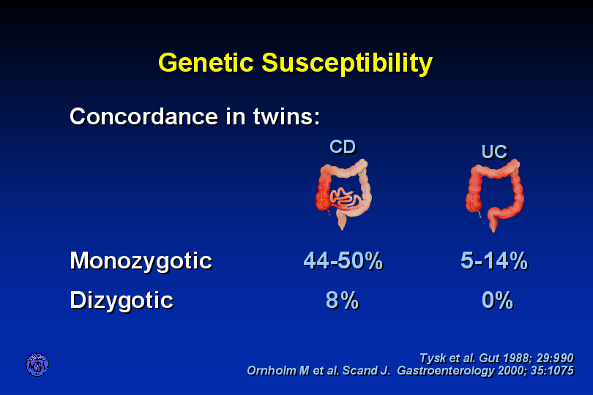

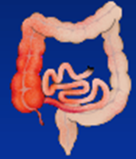
Genetic Susceptibility
Concordance in twins
Shows the importance of the environment
Monozygotic
Dizygotic
Notes:
Harold swapped pic of intestines – Chris had said needed reversing during talk

Slide 12
First phase
Data gathering + Gene discovery
>1400 IBD participants
620 controls
Most participants have given a DNA sample and completed extensive dietary and risk factor questionnaires

Slide 13
Collection of samples in New Zealand
Auckland/NZ: ~400 Crohn’s disease patient samples
Christchurch: ~1200 IBD patient samples
New Zealand: ~1000 control samples

Slide 14
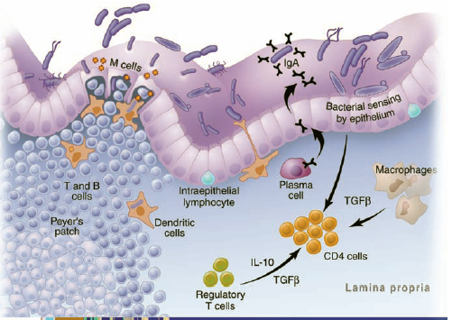
Tumour necrosis factor alpha (TNFα)
Pathways
Toll-like receptor signaling pathway
Cytokine-cytokine receptor interaction
TGF-beta signaling pathway
MAPK signaling pathway
Apoptosis
Key player in development and control of inflammatory response
TNFα
From: TT Macdonald and G. Monteleone, Science (2005) 307, 1920 -5

Slide 15
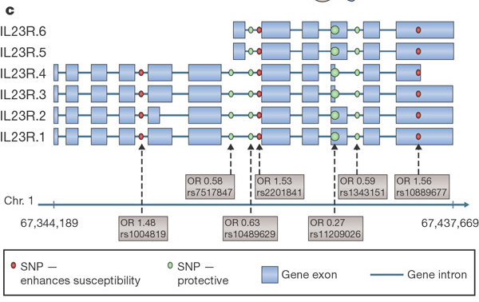
Interleukin 23 receptor
Schematic representation of IL23R isoforms and susceptibility loci implicated in Crohn's disease.
From: Xavier and Podolsky, Nature 448, 427-432 (2007)

Slide 16
Schematic depiction of autophagy
Xie and Klionsky (2007) Nature Cell Biology 9, 1102-9
Notes:
ATG16L1 is a key component in the formation of autophagosomes
Autophagy is a process whereby damaged organelles or proteins are encapsulated inside a double membrane and targeted for lysosomal degradation
Recently it has become clear that the autophagy pathway is also a crucial component of the innate immune system and is capable of capturing and degrading intracellular pathogens

Slide 17

Genotypes common in CD in NZ become candidates for high throughput screens
CARD15
TNFα promoter
ATG16L1
IL23R
OCTN2

Slide 18
Other CD susceptibility genes
Other genes may be important.
The majority of them are involved in the same processes as CARD15, IL23R, and ATG16L1
Not all pathways seen in overseas studies appear important in New Zealand
A good example is the autophagy pathway, which does not seem as important as other pathways in Auckland.
Gene-diet interactions may obscure the role of other pathways…

Slide 19
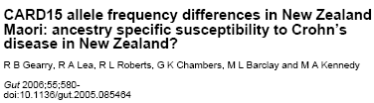
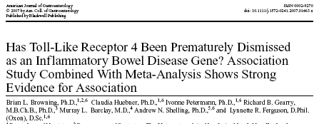
Gene discovery
Single nucleotide polymorphisms in the promoter of the Tumor Necrosis Factor-alpha gene affect the risks of developing Inflammatory Bowel Diseases: New Zealand data and a meta-analysis.
Lynnette R. Ferguson, Claudia Huebner, Ivonne Petermann, Richard B. Gearry, Murray L. Barclay, Pieter Demmers, Alan McCulloch, Dug Yeo Han
Submitted for publucation

Slide 20
Key genes in CD – overlap with
Eczema
Asthma
Rheumatoid arthritis
Type 1 diabetes
Type II diabetes
Psoriasis
Lupus

Slide 21
Problems with Gene Discovery approach PTPN2 SNP rs2542151
Genotype | Controls | Cases
AA | 9 (1.8) | 20 (6.0)
AG | 161 (31.3) | 112 (33.6)
GG | 344 (66.9) | 201 (60.4)
Cochran – Armitage test for trend
(Chi-squared with 1df) p-value = 0.0055.
 | Odds ratio | Confidence Interval
AA | 3.80 | 1.70 – 8.51
AG | 1.19 | 0.88 – 1.60
GG | 1.00
Notes:
See key role of AA homozygote

Slide 22
Problem #1: Sample Size
Sample Size | p-value
Data = 847 | 0.005466 | 5.5E-03
1694 | 0.000085 | 8.5E-05
3388 | 0.000000 | 2.8E-08
P-value is a function of sample size
But we have recruited (approached)
a large fraction of all CD sufferers in New Zealand

Slide 23
Problem #2 Multiple comparisons
Consider testing 2 unlinked SNPs, neither with any effect on IBD
Probability that (at least) one SNP gives a “significant” p-value (< 0.05)?
0.05 + 0.05 – 0.05 x 0.05 = 0.0975
NOT 0.05

Slide 24
 |  | Odds ratio
STAT3 | Genotype AA AG GG | 1.7 1.2 1.0
rs744166 | p-value | 0.02
STAT3 | Genotype CC CT TT | 1.0 1.2 2.0
rs3816769 | p-value | 0.006
JAK2 | Genotype AA AC CC | 1.0 2.0 2.5
Rs10758669 | p-value | 0.0003

Slide 25
Are the observed results sufficiently far from the line expected from Chance variation to be interesting?
All values below line expected by chance

Slide 26
Adjusting for Multiple comparisons
- Testing > 60 SNPs
Simes False Discovery Rate (FDR)
Uses Benjamini & Hochberg procedure
10 SNPs have raw p-values <0.05
SNPs with smallest p-values of interest

Slide 27
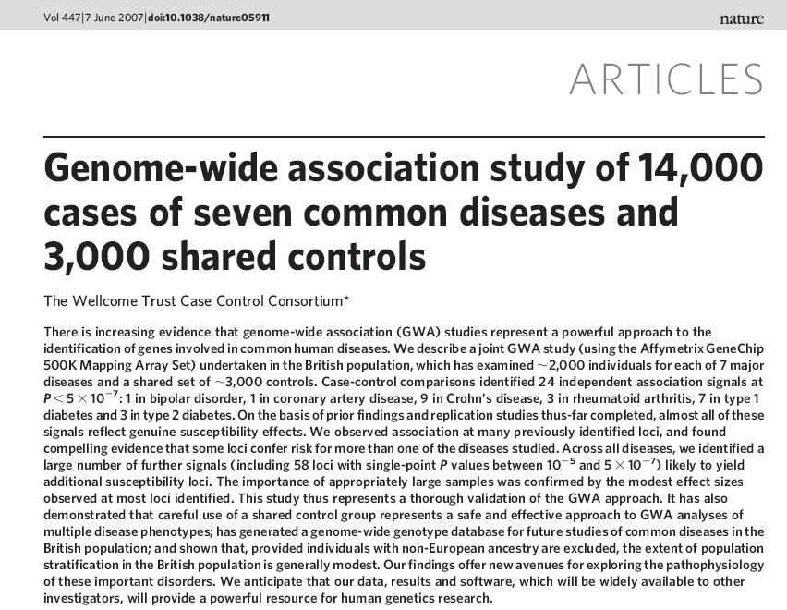
The Wellcome Trust Case Control Consortium
Genome-wide association study of 14,000 cases of seven common diseases and 3,000 shared controls
Vol 447, 7 June 2007, doi:10.1038/nature05911

Slide 29
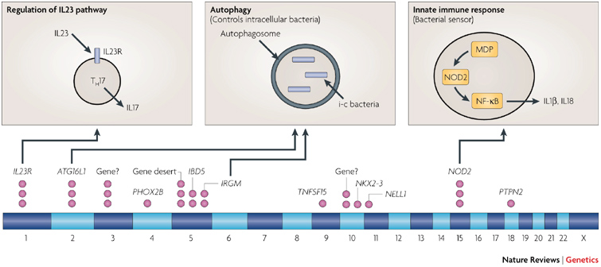
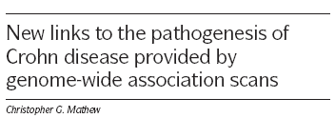
Key genes group to three main pathways

Slide 30
Dietary questionnaire
257 foods and drinks
individuals’ perception of food tolerances
food-related symptoms
comments and commentary
supplements, medication, surgery

Slide 31

Crohn’s disease diet

Slide 32
Crohn’s disease diet
For decoration only!

Slide 33
Dietary preferences and intolerances
Intolerance
Mushrooms
Red wine
Corn
Soy milk
Yoghurt
Oily fish
Apples
Beneficial effect
Mushrooms
Red wine
Corn
Soy milk
Yoghurt
Oily fish
Apples

Slide 34
Food Questionnaire
15 Food Categories
Each category 8 – 44 specific food options
257 specific food types
Makes condition worse |  |  | Makes condition better
Definitely | Probably | No Difference | Probably | Definitely
Score 0 | Score 1 | Score 2 | Score 3 | Score 4
476 responses
low non-response rate
Notes:
34

Slide 35
Can we find foods that
benefit substantial proportion of people
hurt substantial proportion of others
Are there neutral foods - low proportions of both Score 0 and 4?
Goals
Cluster foods
good and bad
look at distribution of ordered responses 0(--) → 4 (++)
Cluster subjects
profiles of response
link to genotype
476 (subjects) x 15 (Food Type) matrix
Or 476 x 269 matrix
Ordered Scale 0 = -- → 4 = ++
Notes:
With the information gathered from the questionnaires we are going to answer the following questions:
Are there foods that….
In order to get this output we want to cluster…
35

Slide 36

Look at distribution of ordered responses 0 = Def. worse → 4 = Def. better
Underlying continuous latent variable,
Modeling the cumulative probability, λ_{i,k} of ordinal score k for food i
Density
Density
Use of cut points θ_{k} to define probabilities of ordinal categories, P_{i,k}
Density
Density
Notes:
36
We built our model based on McCullagh’s ordinal regression.
Instead of directly model the ordinal outcome, we make use of the underlying continuous latent variable,
For example, the percentage of plant infected by late blight.
We model the cumulative probability of ordinal score and the ordinal scores are defined by the estimated cut-points.

Slide 37
First answers
Muesli Bars | Croissants | Pancake
Doughnuts | Cake | Plain Biscuits
Chocolate Biscuits | Muffins | Pita FlatBread
Corn Crackers | Scones | Rice Crackers
Sweet Buns
Higher proportion of Definitely or Probably better
Higher proportion of Definitely or Probably worse
Foods don’t cluster Spectrum of response
Notes:
37
37

Slide 38
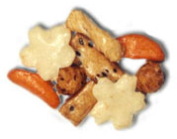
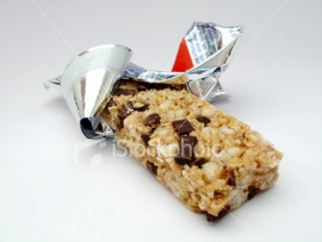
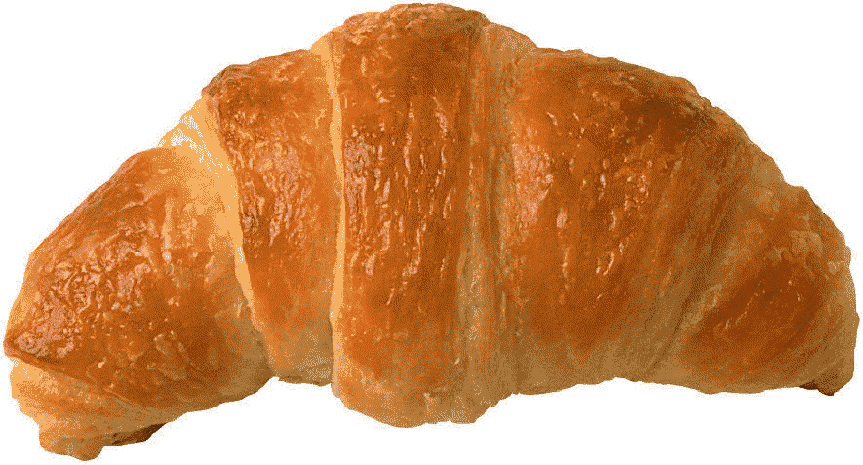


Biscuits
RiceCrackers
MuesliBars
36% report adverse effects

Slide 40
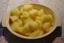
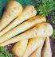
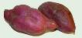


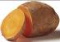
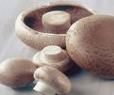
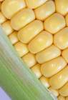
Vegetables
44
42
40
41
39
37
23
43
38
30
24
35
17
Increasing beneficial effects
32
28
27
12
11
19
18
26
16
7
3
25
20
15
21
31
10
4
6
34
14
9
8
5
22
2
1
36
29
13
33
Increasing adverse effects
Notes:
We couldn’t wait to finally get our hands on the questionnaire data analysis Chris has performed (or as we got to see Chris’ analysis) we flicked through the different food groups and had a closer look at the vegetables. And what hit our eyes was a group of 5 vegetables that stand out at the top left corner: parsnip, carrot, kumara, boiled potatoes, yams, pumpkin. They all have comparable results: 5.2% reported adverse effects, 8,1% reported beneficial effects.
And then 2 data points at the bottom right drew our attention - Corn and mushroom. Both have high proportions of reported adverse effects 49%, 39% and low proportions of reported beneficial effects 1.8% and 2%. The majority of individuals with Crohn’s disease seems to have problems with those foods.
Interestingly we immediately associated the mushrooms with a known fact – they contain ergothioneine!

Slide 41
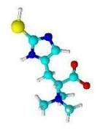
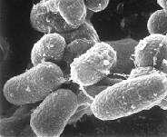
Ergothioneine (ERT)
highest concentrations in mushrooms
antioxidant
highly accumulated in red blood cells
can not be produced by humans
produced by fungi and mycobacterium
(avium subspecies paratuberculosis)
possible link to Crohn’s disease
Notes:
In fact – mushrooms show the highest levels of Ergothioneine in food. What is Ergothioneine.
Ergothioneine is an amino acid with strong antioxidant properties. It is highly accumulated and preferentially localized within erythrocytes, in the liver, kidney’s and eyes where it provides cellular protection against oxidative stress. It is highly accumulated in red blood cells and can not be produced in humans. It is available only in the diet mainly from plants. Plants and fungi sequester ergothioneine from the soil where it is produced by fungi and mycobacterium such as mycobacterium avium paratuberculosis.
One controversial hypothesis of the cause of CD is that a specific infection with MAP drives mucosal inflammation.
But in fact it might not be the bacterium itself but one of it’s products and it’s somewhat imbalanced uptake in CD individuals.

Slide 42
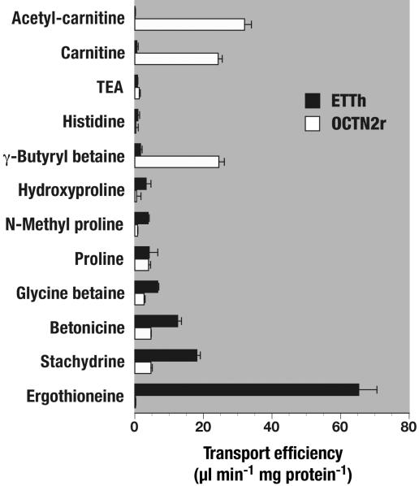
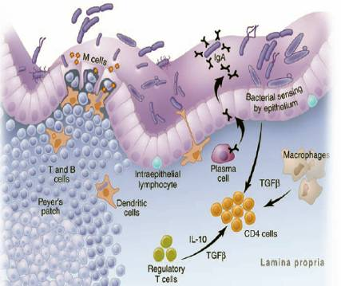
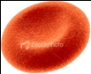
OCTN 1 transports ergothioneine
OCTN1h
OCTN1
Organic cation transporter SLC22A5
Grundemann et al. (2005)
Notes:
Here comes another fact into play that makes the mushroom’s ergothioneine content so interesting for us to study in CD. That is the organic cation transporter OCTN1! Grundemann et al identified this transporter as being THE ergothioneine transporter in 2005.
Carnithine → FA co-transport into mitochondria
Ergothioneine → antioxidant

Slide 43
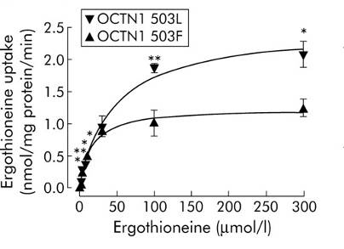
OCTN1- Gain of Function Variant
OCTN1 503F has 50% greater initial ergothioneine (10mM) transport capacity
Accumulation of ergothioneine in 503F carriers
Possible risk factor for CD
OCTN1 WT
OCTN1 503F
Taubert et al. (2005)
Notes:
In the same year, Taubert et al showed that one non-synonymous SNP at position 503 leads to a gain of function of the transporter showing an increased initial transport capacity for ergothioneine.
In other words carriers of the 503F variant might accumulate higher levels of the antioxidant ergothioneine in the cells (blood cells) which might trigger oxidative stress and may be therefore a risk factor in Crohn’s disease.

Slide 44
OCTN1 and CD in New Zealand
Our study: Leu503Phe (rs1050152) C/T p=0.9 UC+CD, p=0.56 CD p=0.39 UC
814 patients 409 controls
No paper to Nature with these p-values
Notes:
We have been studying this variant in our IBD cohort and as you know we couldn’t show a significant association of the OCTN1 non-synonymous SNP with CD patients in our cohort.
But with the biological background in mind and the new dietary questionnaire data the picture changes

Slide 45
Vegetables
44
42
40
41
39
37
23
43
38
30
24
35
17
Increasing beneficial effects
32
28
27
12
11
19
Analysis:
adverse effect beneficial effect
Match with OCTN1 genotype
18
26
16
7
3
25
20
15
21
31
10
4
6
34
14
9
8
5
22
2
1
36
29
13
33
Increasing adverse effects
Notes:
We analysed the 39% of people that reported adverse effects and the 2% of people that reported beneficial effects after eating mushrooms and match the dietary data with their OCTN1 genotype.

Slide 46
OCTN1 – mushroom analysis
p=0.01
Accumulation of ergothioneine in 503F carriers may be a risk factor for CD
Notes:
Grand Total 120 197 83
And we got this result!! The graph shows the % of people with a certain genotypes accross the different response groups (def worse to def better) and I have left the makes no difference box out. What we can clearly see is that the adverse effect response is significantly increased (p=0.01) in CD individuals carrying the risk T allele. The proportion of the wildtype C allele increases towards individuals with CD that reported beneficial effects. The most exciting point for us was that after Chris Triggs had applied the Fisher exact test he proofed it to be statistically significant.

Slide 47
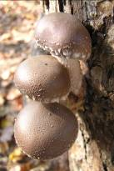

First gene – diet association in our study!
OCTN1 itself doesn’t seem to be a consistent
causative genetic marker for CD
• When food comes into play the genotype
becomes significantly important

Slide 48




Acknowledgements
Notes:
48

